Slide 1
Slide 1: IA Maker’s Fund Disbursement Process
Title: Workflow for Fund Disbursement
Subtitle: Step-by-Step Process.

Slide 2
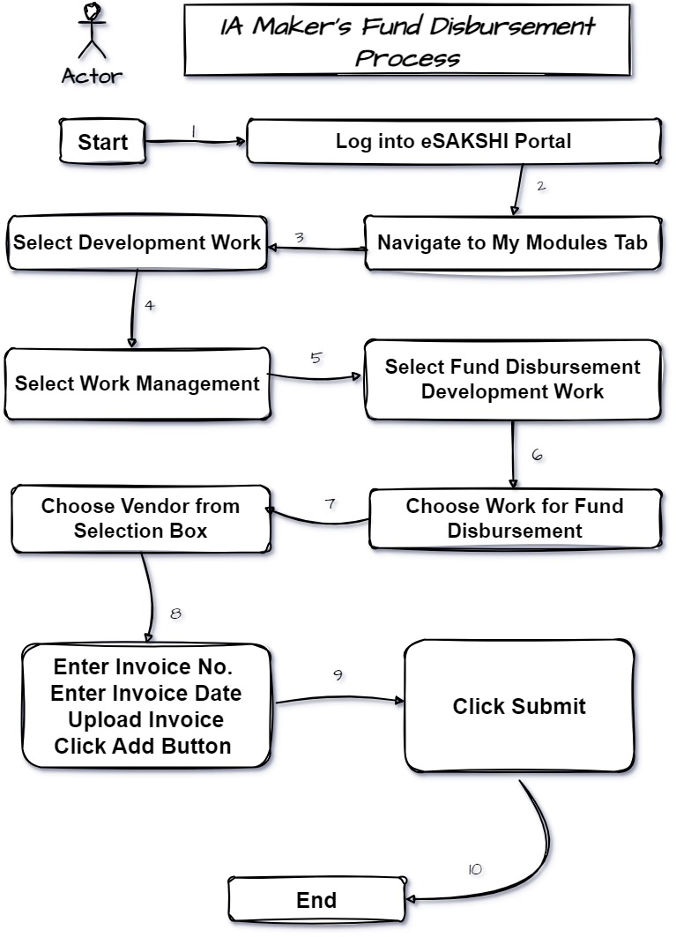
Slide 2: Workflow Image
Title: Fund Disbursement Workflow
Content: Insert the image of your workflow.

Slide 3
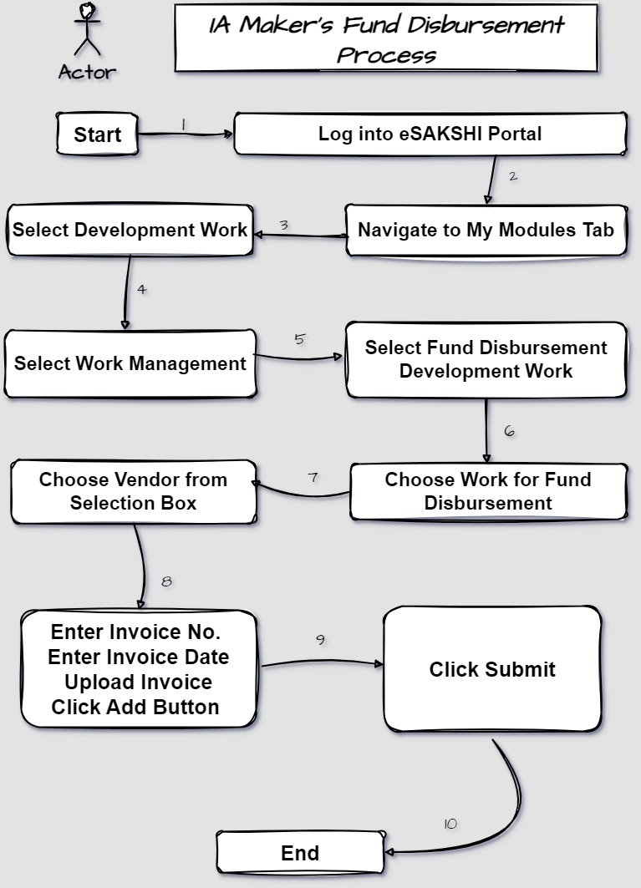

Slide 4
Slide 3: Step 1-2
Title: Initial Steps
1. Log into eSAKSHI Portal
2. Navigate to My Modules Tab

Slide 5
Slide 4: Steps 3-5
Title: Selecting Development Work
3. Select Development Work
4. Select Work Management
5. Select Fund Disbursement Development Work

Slide 6
Slide 5: Steps 6-8
Title: Choosing Work and Vendor
6. Choose Work for Fund Disbursement
7. Choose Vendor from Selection Box
8. Enter Invoice No.

Slide 7
Slide 6: Steps 9-12
Title: Completing the Submission
9. Enter Invoice Date
10. Upload Invoice
11. Click Add Button
12. Click Submit

Slide 8
Slide 7: Conclusion
Recap: Summarize the workflow steps.
Importance: Emphasize the accuracy and efficiency of the process.

